Slide 1
Transformation Mapping of Bubbles’ 2-D Circular Shape to an Elliptical Shape Under Influence of a Magnetic Field in Pool Boiling in Microgravity Conditions.
by
Thilanka Munasinghe
West Virginia University,
Morgantown, USA
thilanka.munasinghe@mail.wvu.edu.

Slide 2
The “Key” Terms :
Pool Boiling
Microgravity
Bubble characteristics

Slide 3
What is Pool Boiling ?
How can we do pool boiling ?
Pool Boling is a method of boiling and generating bubbles in a liquid that can boil in a container with a heat resource.
There are several ways that can do the pool boiling and one of the common ways is boiling in a cylindrical tank as we used in our experiment.

Slide 4
What is “Microgravity” ?
micro level (10⁻⁶) = μ = 0.000001
g= 9.81 m/s² ( Earth’s gravity level)
μ g= [0.000001] X [ 9.81 ]
= 0.00000981 m/s²

Slide 5
Pool Boiling in two identical tanks with a paramagnetic liquid
Paramagnetic liquid – MnCl_{2 (aq)} + H₂O

Slide 6
Why We need a Paramagnetic Liquid?
In order to avoid the floating of the liquid inside the tank due to lack of gravity, paramagnetic liquid will be used to attach the liquid to the bottom surface of the tank by using a permanent magnet.

Slide 7
Bubble Behavior
Bubble’s travel path inside the tank.
Size of the bubble ( vertical and horizontal radius).
Bubble’s shape deformation comparatively to the original shape.

Slide 8
How to create a “Microgravity” conditions artificially ?
Parabolic path of an aircraft can create “Microgravity” conditions within a short period of time such as 20-30 seconds period in a one parabola.

Slide 9
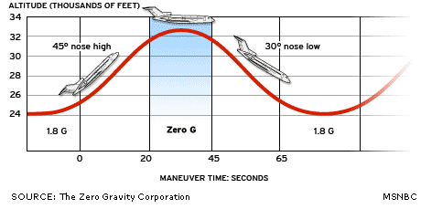
Parabolic path of the aircraft that can create
microgravity condition

Slide 10
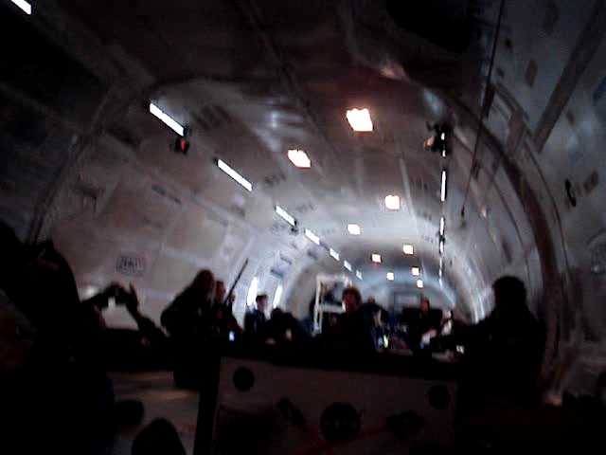

Slide 11
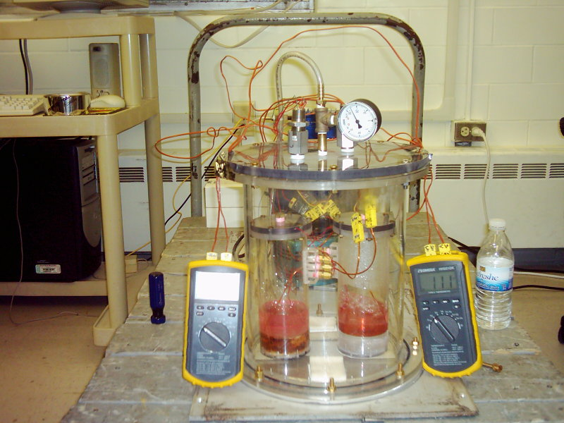
Experiment apparatus before the flight

Slide 12
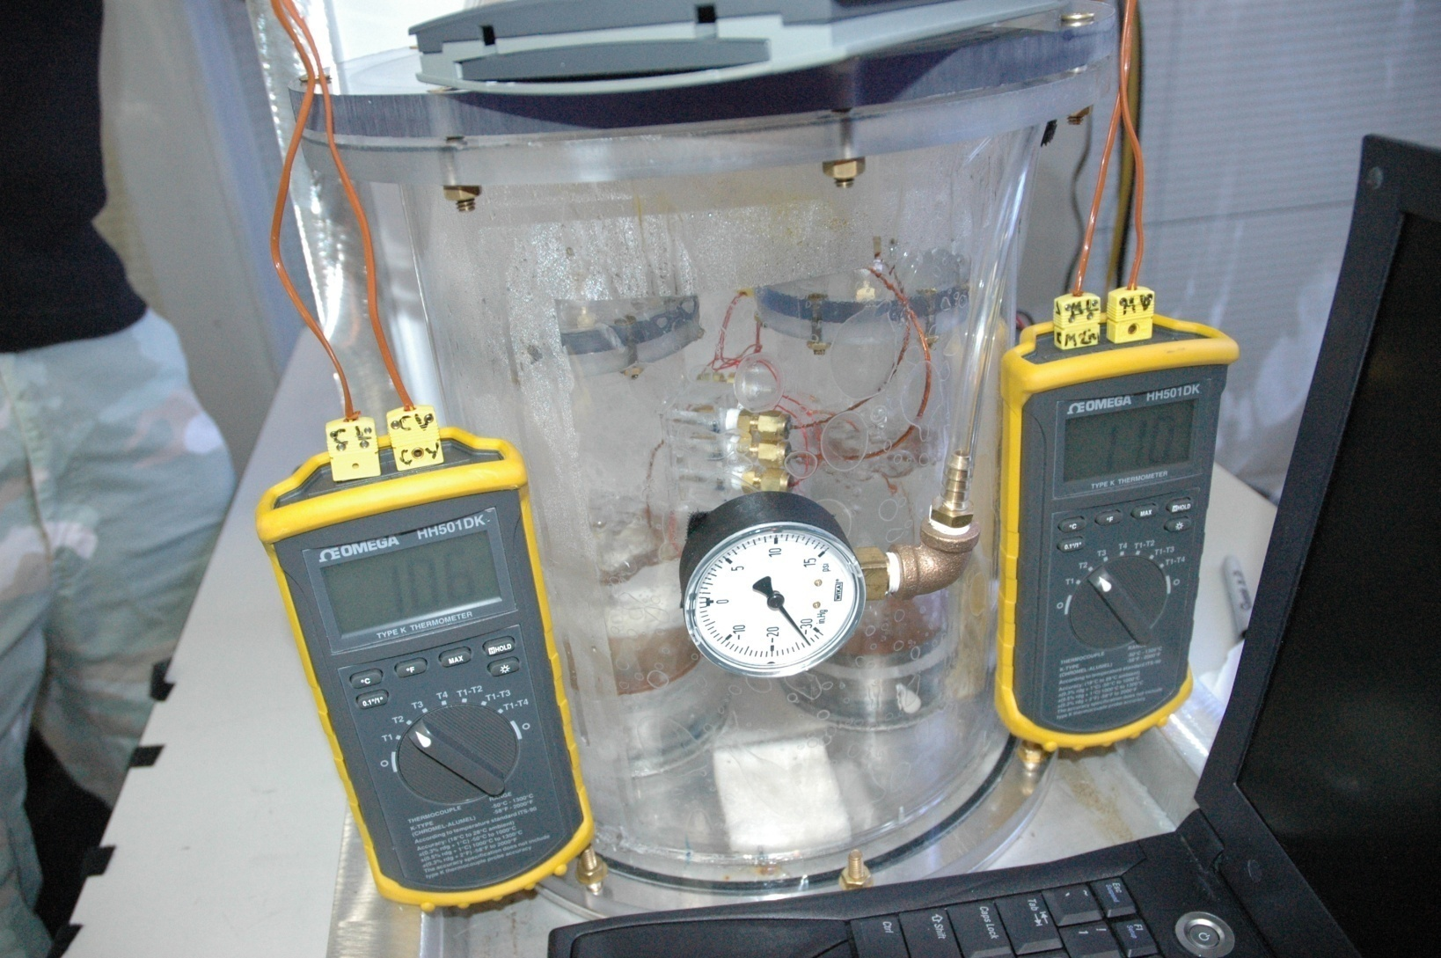
Closer look of the experiment set up

Slide 13
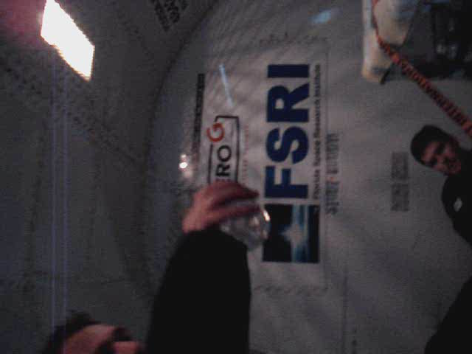

Slide 14
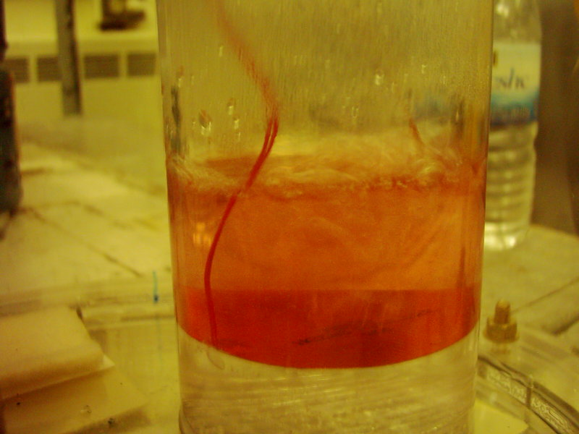
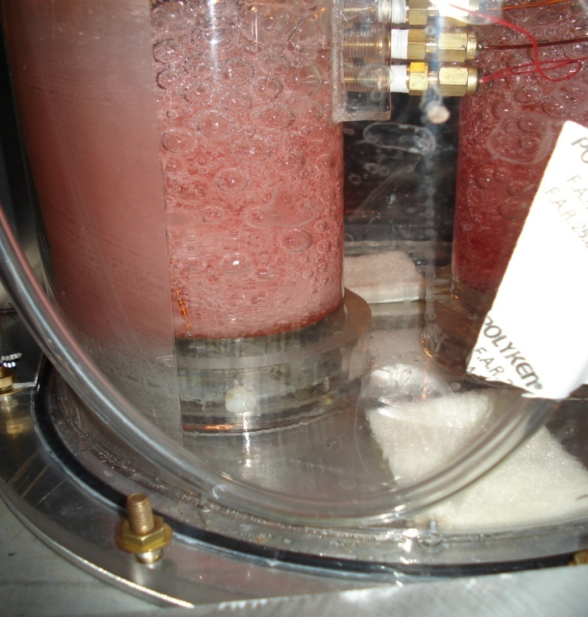
Boiling in Earth’s
Boiling behavior during the microgravity period

Slide 15
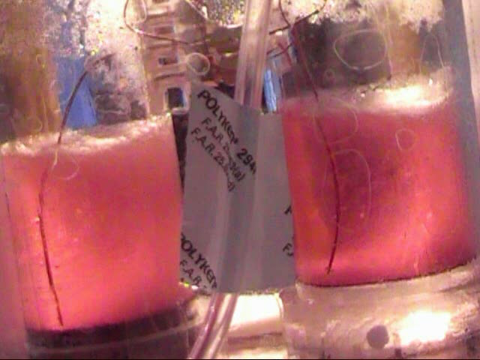

Slide 16
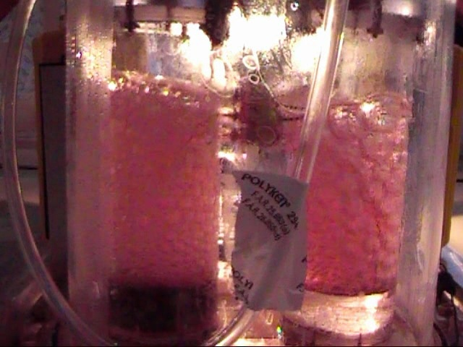

Slide 17
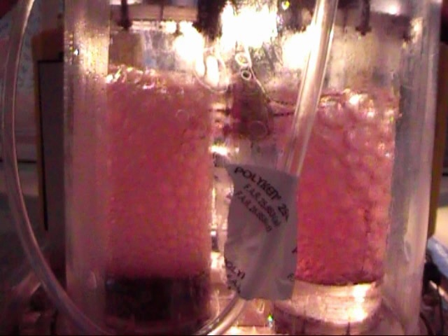

Slide 18
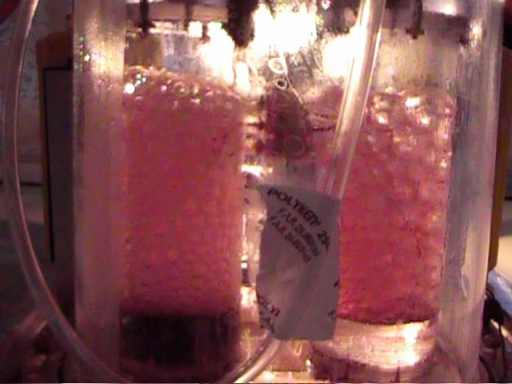

Slide 19
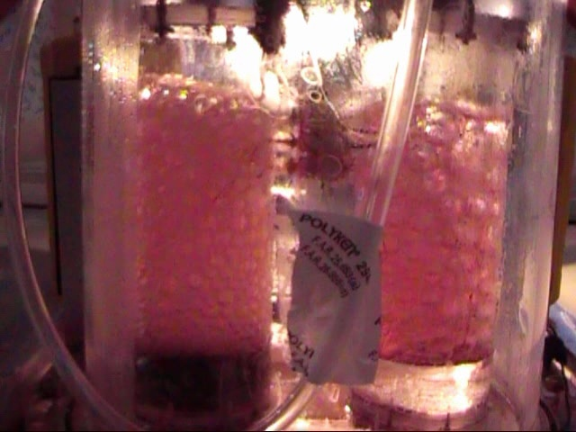

Slide 20
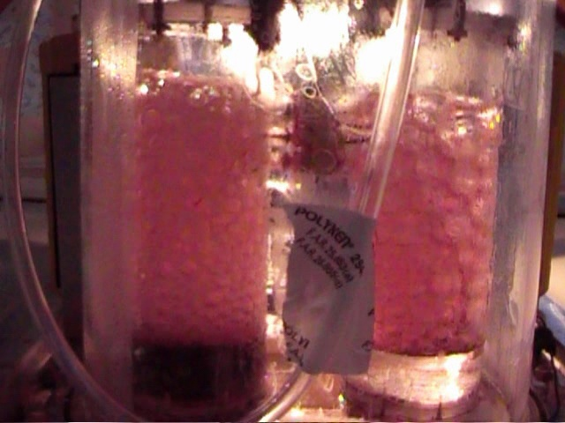

Slide 21


Slide 22
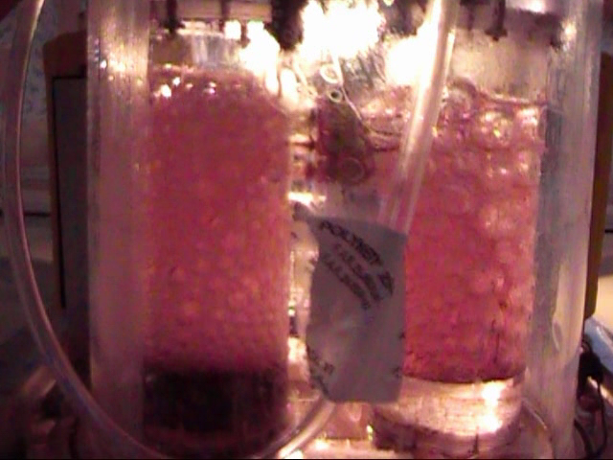

Slide 23
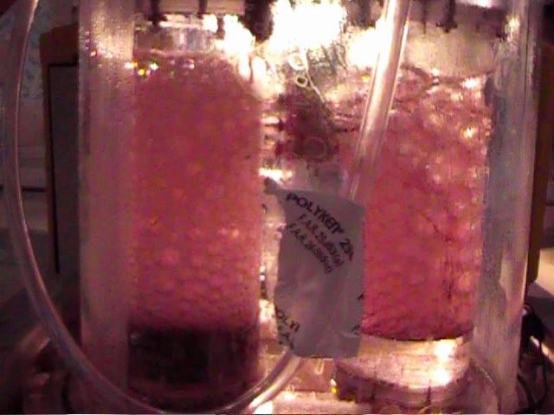

Slide 24
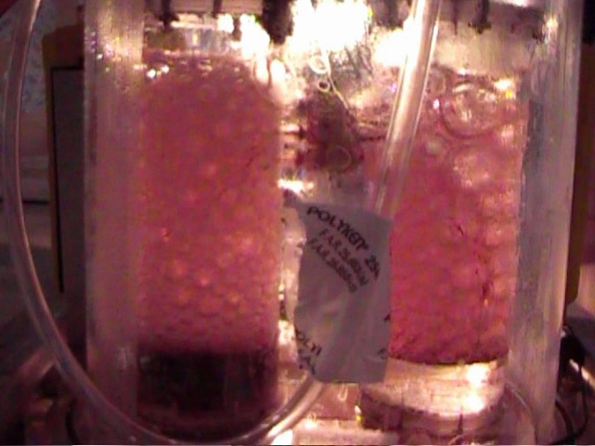

Slide 25
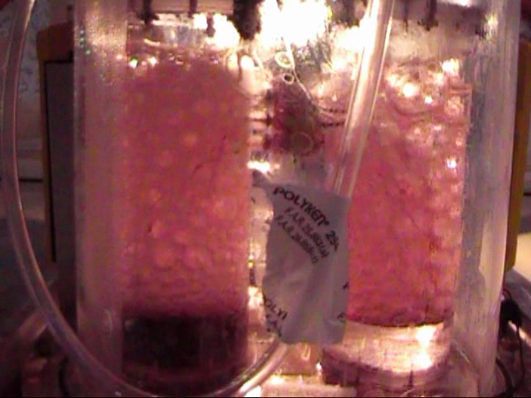

Slide 26


Slide 27
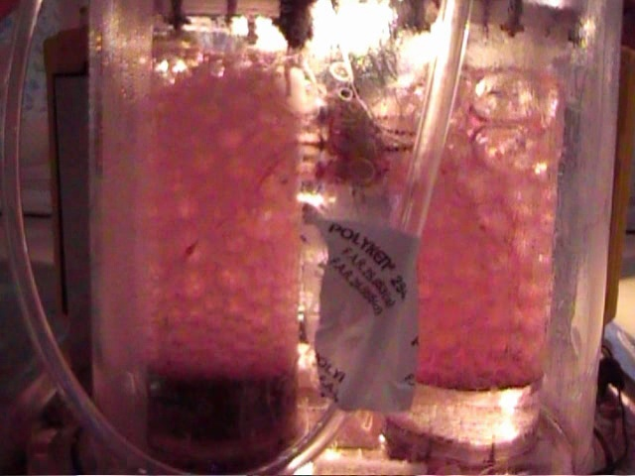

Slide 28
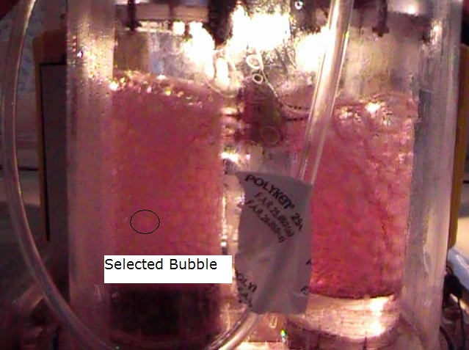

Slide 29
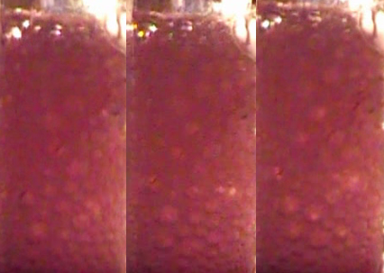
Bubble’s coordinates on the perimeter
Three consecutive bubble frames

Slide 30
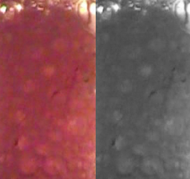
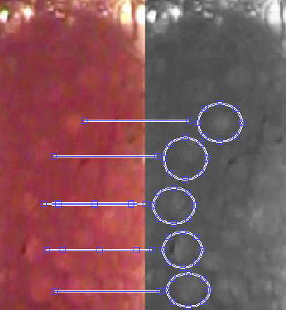
(1)
(2)
(1) Colour image and Gray scale image
(2) Location of the bubble on gray scale image with respect to the colour image
Colour Images has converted to gray scale images and bubble location has determined.

Slide 36
Possible practical applications of Pool Boiling in microgravity
Pool boiling in Microgravity conditions can use as a “Cooling Process” for out of Earth conditions specially inside the ISS (International Space Station)
Space applications that are related to liquids and bubbles
that related to many fields such as Space medicine, Space Agriculture, Heat transfer ..etc

Slide 37
Conclusion:
In microgravity conditions boiling process take place faster than Earth’s gravity.
At the bottom of the tank the bubble’s vertical radius is comparatively smaller than the horizontal radius.
As the bubble goes along the tank, the strength of the magnetic field reduces and eventually the vertical component of the radius gets bigger than the horizontal radius.
While the bubble travels upwards, bubble movement demonstrates a 2-D spiral path along the tank.
Horizontal and vertical radius, bubble area, bubble path along the vertical axis of the tank was graphed verses bubble frame number for the detailed characteristic study of bubbles.
These bubbles also were observed to be elliptical and in real visualization it is in 3-D.

Slide 38
Reference :
A. Fujiwara, Y. Danmoto, K. Hishida, “Bubble Deformation and Surrounding Flow Structure Measured By PIV/LIV and Shadow image Technique”, ASME_JSME 4th Joint Fluid Engineering Conference, F E DSM200 3-4 5674, Honolulu, Hawaii, USA, July 2003.
S. Toshiyuki, M. Watanabe,T. Fukano, “Study On Single Bubble Chain in Stagnant Water”, ASME_JSME 4th Joint Fluid Engineering Conference, F E DSM200 3-4 5381, Honolulu, Hawaii, USA, July 2003.
M. Ashihara, A. Kitagawa, M. Ishikawa, A. Nakashinchi, Y. Murai, F Yamamoto, “Particle Tracking Velocimetry Measurement of Bubble-Bubble Interaction”, ASME_JSME 4th Joint Fluid Engineering Conference, F E DSM200 3-4 5208, Honolulu, Hawaii, USA, July 2003.
T. Munasinghe, “Investigating the Bubble Behavior in Pool Boiling in Microgravity Conditions,” WCE 2008, vol. II, pp. 1366–1371, London, UK, July 2008.
C. Maneri, P Vassallo, “Dynamic of Bubble Rising in Finite and Infinite Media” ASME_JSME 4th Joint Fluid Engineering Conference, F E DSM200 3-4 5208, Honolulu, Hawaii, USA, July 2003.

Slide 39

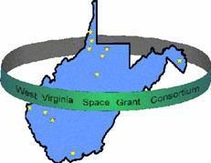
Acknowledgement
Special Thanks to:
NASA -West Virginia Space Grant Consortium at WVU.
West Virginia University, College of Engineering and Mineral Recourse.
Mechanical and Aerospace Engineering Department of WVU.
Dr. John Kuhlman , Dr. Donald Gray,
Dr. Majid Jaraiedi , Dr. Arun Ross and Microgravity Research Team.
Zero Gravity Cooperation.

